Slide 1


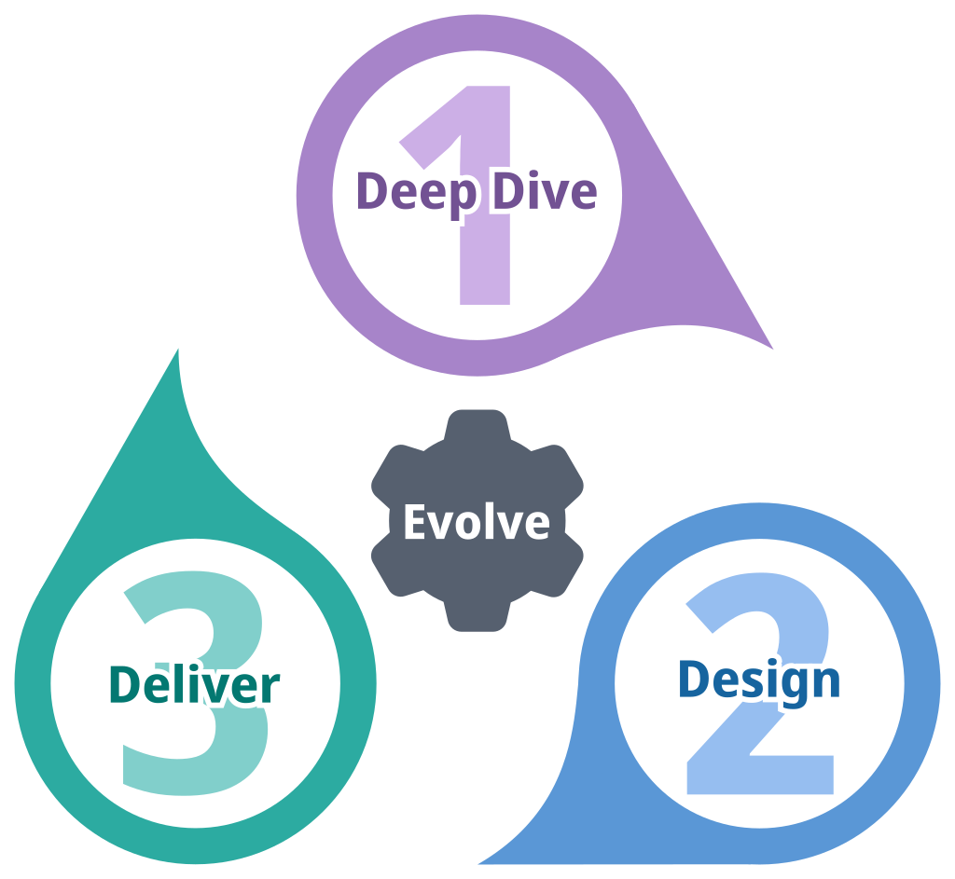
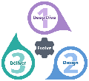
QI Snapshot
Getting the most out of the QI Snapshot Template
The QI Snapshot template serves two valuable purposes:
Helping you record and track active small quality improvement changes
Documenting the approach and outcomes of completed changes
Engagement Tips:
Be Brief: Keep your text concise, focusing on the most important points to make it engaging.
Visuals Matter: Utilise pictures and graphs to present data and showcase the work you have done.
These QI snapshots are perfect for sharing with others to celebrate successes, inspire new quality improvement initiatives, and foster a culture of continuous improvement.
There are two different formats for you to use. Take your pick!
Produced by: Improvement & Transformation Team

Slide 2
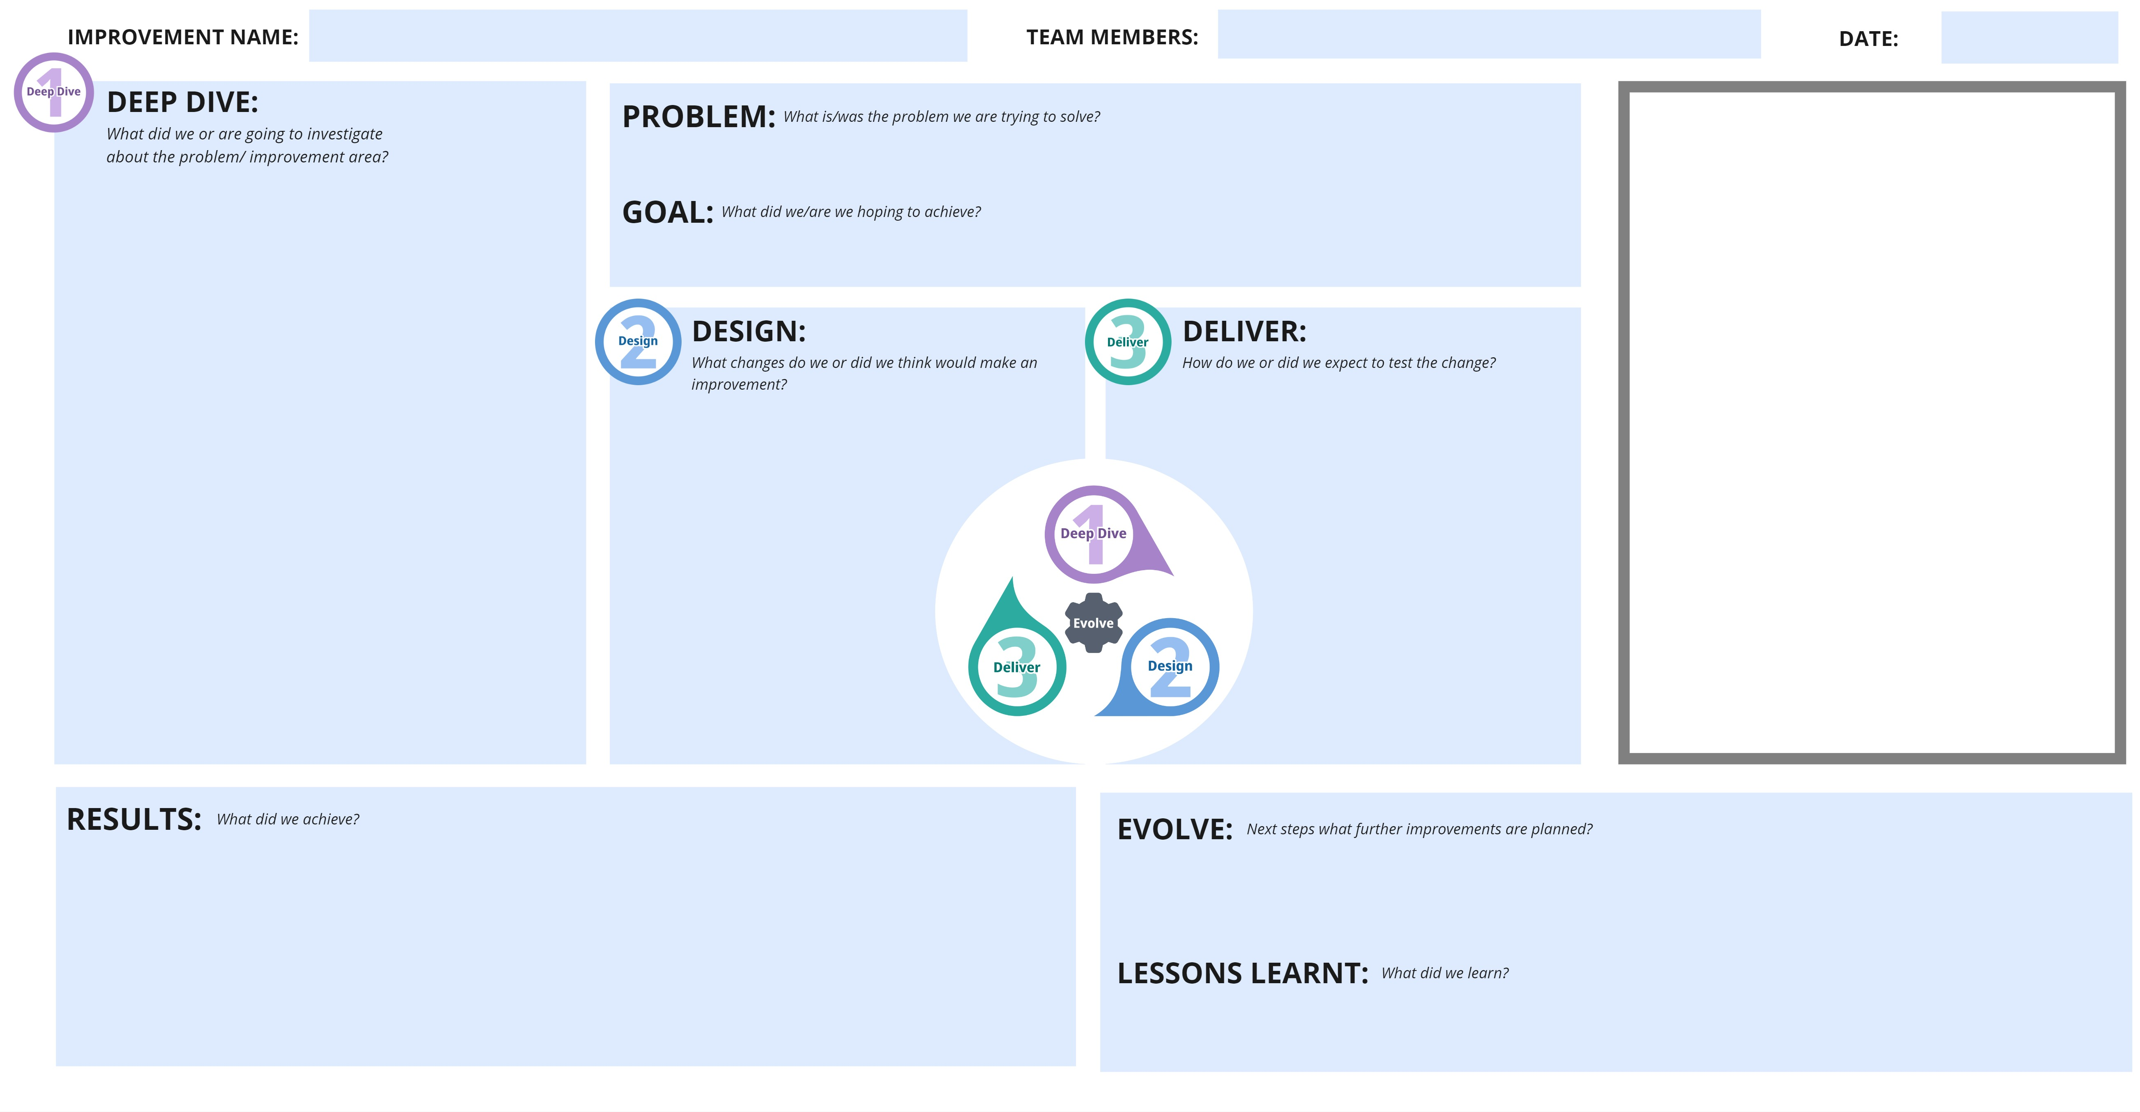

QI Snapshot
Click to edit
Click to edit
Click to edit
Click here to add a picture/graph
Click to edit
Click to edit
Click to edit
Click to edit
Click to edit
Click to edit
Click to edit
Produced by: Improvement & Transformation Team

Slide 3
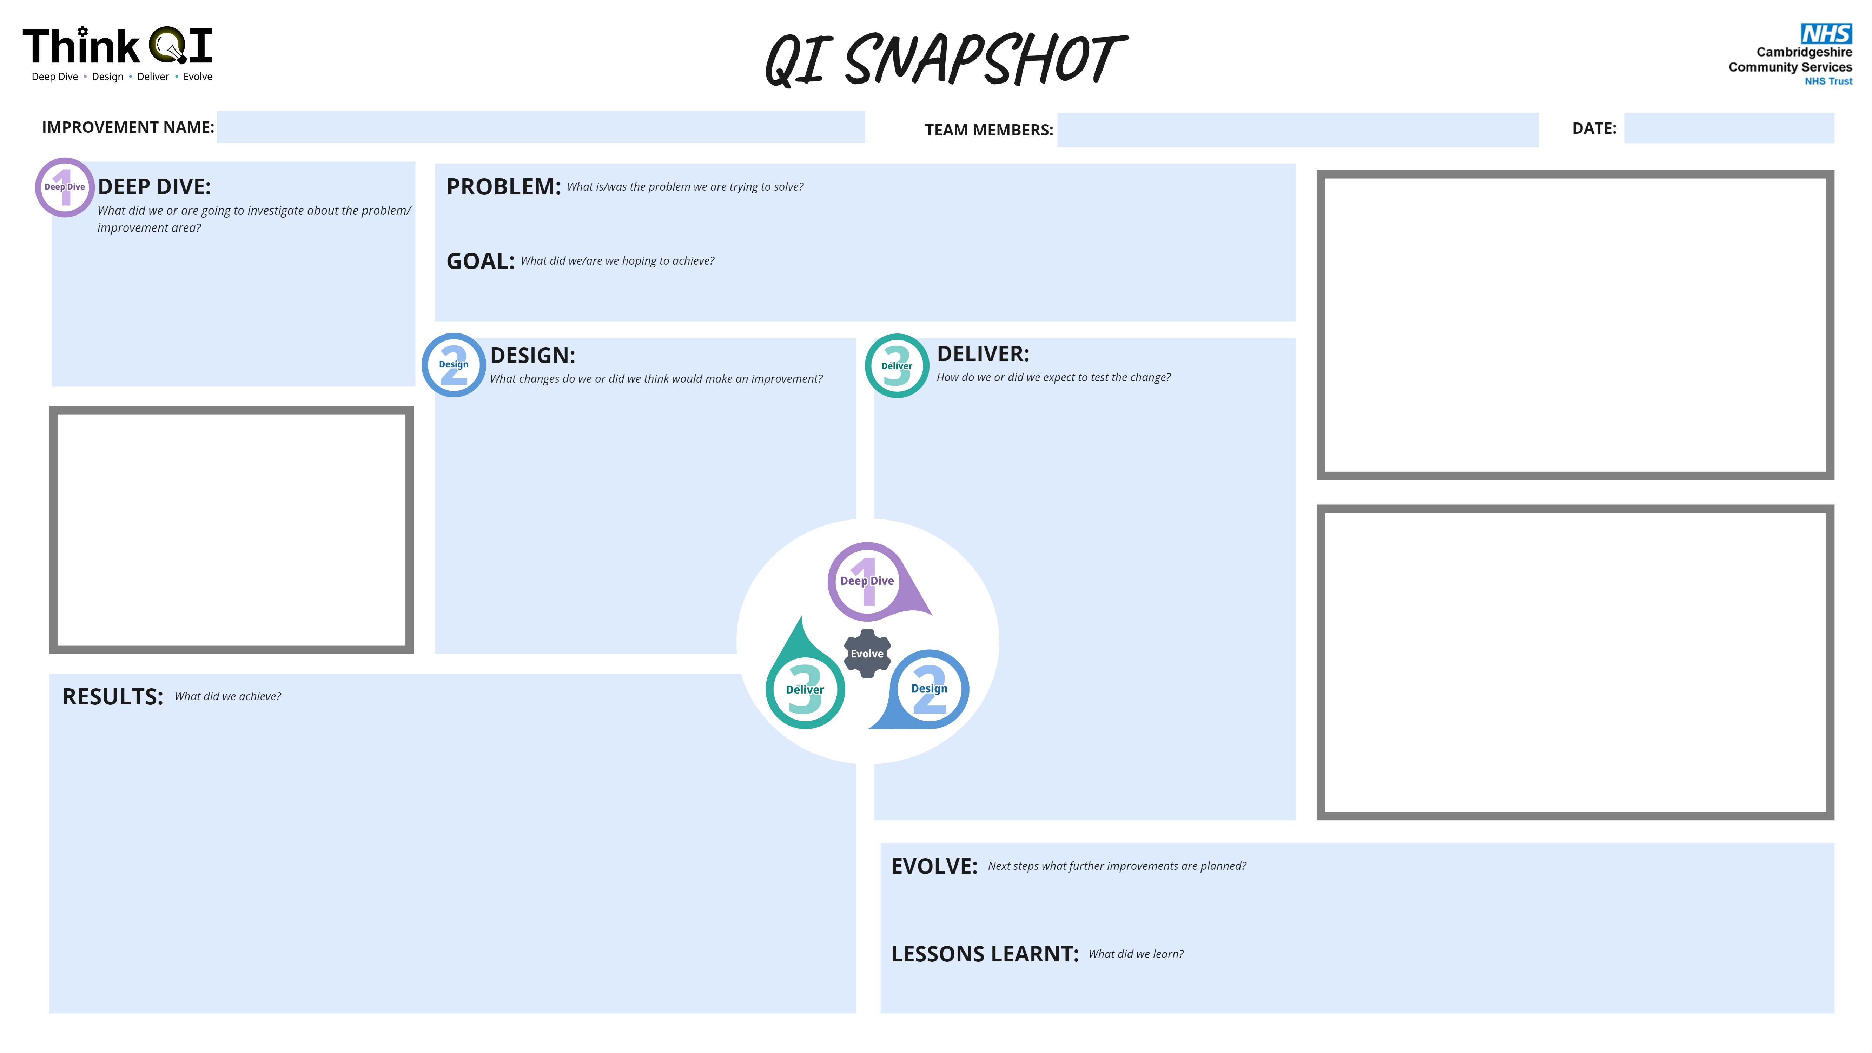
QI Snapshot
Click to edit
Click to edit
Click to edit
Click to edit
Click here to add a picture/graph
Click to edit
Click to edit
Click to edit
Click to edit
Click here to add a picture/graph
Click here to add a picture/graph
Click to edit
Click to edit
Click to edit
Produced by: Improvement & Transformation Team

