Slide 1
Survey results

Slide 3
Do you feel equipped with the necessary skills for career development?

Slide 4
Perceived challenges to career progression
Not enough time - too busy, need more time on specialism – hard when service challenges, not enough time for CPD/training
Not enough opportunities – not enough clinical B7 posts, if not interested in managing then limited, limited new B6 posts, based on service needs not personal clinical interest
No money
Flexibility – feel would affect work/life balance, not possible with a family/working part time.
SLTAs – no progression for B4s unless do a degree, limited opportunities for CPD
Training – no management training, some prioritised for management training,

Slide 5
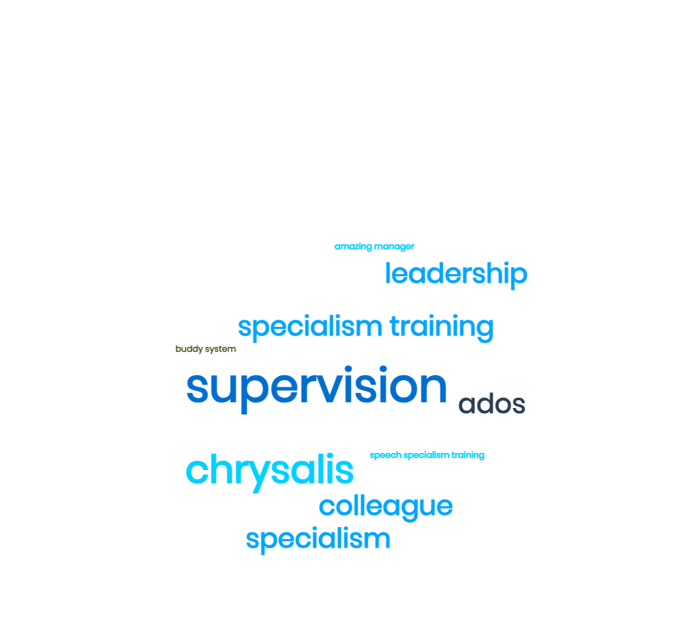
What specific skills or training have you received that has helped you develop in your role?

Slide 6
What additional training or skill development opportunities would you like to see?
Leadership training
Shadowing
Opportunities for developing skills at higher band
Protected clinical time for management roles
Delegation from management for ‘smaller tasks’ to build skills
Reverse mentoring
People management
Band 6 development- workshop of what skills need to be developed for the next stages (working and interviewing)
Clearer development pathway
Apprenticeships

Slide 7
Are there any specific resources or support systems you feel are lacking?
25% no/not sure
Small group CPD sessions related to specialism
Group sessions for banding eg all B6s
Mentoring/peer support
More support systems related to diversity
Supervision not just from line manager
Spending time with colleagues

Slide 8
As our service evolves to meet future challenges and opportunities, we are keen to understand the skills that you believe would be crucial for its continued success.
Adaptable, flexible and creative (biggest response)
Effective, EBP, research-based
Child-focused
Timeliness – see children quickly
Not being too rigid with clinical specialisms
Maintain clinical specialisms
Strong communication internally and externally
Compassionate leadership

Slide 9
Would you be open to sharing the specific steps and training you have gone through to get to your current position? This would be in the shape of a staff story, to help others u
No: 32
Unsure: 14
Yes: 23

